Slide 1

SAP IDoc Introduction
Nicole Mo
ML5100
2013/05/19

Slide 2
Agenda
IDoc Concept
IDoc Configuration Steps
IDoc Creation example

Slide 3
Agenda
IDoc Concept
IDoc Configuration Steps
IDoc Creation example

Slide 4
What is IDoc?
IDocs: Intermediate Documents
IDoc is not a process, an IDoc is simply a data container that is used to exchanged information between SAP and non-SAP systems.
- In the SAP system, IDocs are stored in database tables.
- IDocs are independent of the sending and receiving systems.
- IDocs are independent of the direction of data exchange.
IDocs are Message-oriented, and Asynchronous.
System 1
System 2
Document
IDoc
Document

Slide 5
IDoc Applications
Business
Business
Connector
R/2 System
Connector
R/2 System
Internet
Internet
Intranet
Intranet
ALE
ALE
IDoc
IDoc
EDI
EDI
Subsystem
Subsystem
R/3 System
R/3 System
Other
Other
Workflow
Workflow
Systems...
Electronic
Systems...
Electronic
Form
Form
Notes:
IDOC: 是系统间通用的数据交换的媒介文件，通过IDOC可以方便的和外部系统进行数据交换，它可以内/外传送以实现系统的自动化，在SAP中IDOC主要应用以下技术：
-> ALE: 用于在同一集团中不同的SAP系统之间的数据交换
-> EDI: 实现不同企业间电子数据的交换，通过IDOC文件和业务伙伴进行数据交换
-> 通过IDOC也可以连接其他应用系统， 上图展示的是以IDOC文件交换数据的逻辑示意图，由此可见以它是作为通讯媒介，构成了一个强大的分布且开放的系统。
ALE(Application and Link Enabling)：是SAP专门为SAP之间所设计的整合中间件。
IDOC(Intermediate Document):是SAP提供的系统整合专用的数据/消息格式。
ALE在SAP 3.0版本开始就作为SAP整个应用体系的一部分，为分布式数据交换提供了可靠安全的通讯机制。
ALE是设计结构可以分为三层，即应用层，数据/消分配层和通讯层。
通讯层：是SAP整合机制的基础，它利用远程功能呼叫RFC调用SAP系统的功能模块。
数据/消息分配层：主要提供三个关键服务
a. 按数据分配模型决定数据接收者
b. 消息的过滤和转换
c. 数据/消息的压缩，以提高传递效率。
应用层： 应用层直接与SAP系统接口，生成或从其他系统接收含有路由信息的消息文本Idoc,包括消息接收者的姓名，要求发送的类型以及对消息进行处理的规则。
应用SAP的ALE机制进行SAP与SAP或是非SAP系统整合的好处：
1. ALE技术不受SAP版本升级的影响，它提供了版本向后兼容性. ALE定义与SAP应用层，与SAP的逻辑层相对独立，整个ALE中间件独立发送和接收系统
2. ALE消息设计逻辑保证消息的"一次请且只有一次“的消息传递。ALE采用"存储-发送”技术确保消息即使系统发生故障或是接收方没有准备接收时也可以达到目的地。这样就保证接收方不至于收到重复消息。
3. ALE也提供了IDocs管理功能。主要有文本缩减‘文本版本控制以及文本数据过滤。三种控制机制使得SAP开发人员可以根据实际需要对Idocs文本在运行中进行动态处理
4. ALE提供了系统管理功能，允许对ALE系统进行启动/复位/恢复等系统操作，为开发人员提供了进一步的管理控制。

Slide 6
Process flow: Sending Data
R/3 System
R/3 System
Post document
Generate IDoc
Check partner, find port
Transfer data,
process further
External system
External system
Notes:
1.Application document is created.
2.IDOC is generated
3.IDoc is transferred from SAP to Operating system layer
4.Idoc is converted into EDI standards
5.EDI document is transmitted to the business partner
6.The EDI Subsystem report status to SAP

Slide 7
IDoc Setting: Sending Data
R/3 System
R/3 System
Post document
Partner Profiles
Archive IDoc ?
Generate IDoc
Partner Profiles
Archive IDoc ?
Check partner, find port
Port Definition
Port Definition
External System
External System
Documentation
Transfer data,
Documentation
EDI Subsystem ?
EDI Subsystem ?
Tools
process further
Tools

Slide 8
Process flow: Receiving Data
External System
External System
Send data to
R/3 System
transfer
R/3 System
R/3 System
Check port & partner,
Generate IDoc
Post document
ok?
No
ok?
Error handling
No
Notes:
1.EDI transmission received
2.EDI document is converted into an IDOC
3.IDOC is transferred to the SAP layer
4.The application document is created
5.The application document can be viewed.

Slide 9
IDoc Setting: Receiving Data
External System
External System
Send data to
EDI Subsystem ?
EDI Subsystem ?
R/3 System
Documentation
Documentation
Tools
Tools
Port Definition,
Check port & partner,
Port Definition,
Archive IDoc ?
Archive IDoc ?
Partner Profiles
generate IDoc
Partner Profiles
Post document
ok?
ok?
Error handling
R/3 System
R/3 System

Slide 10
IDoc Record Structures
Control record
IDoc ID
Partner
IDoc type and logical message
External structure
Data records
Control part
Application data
Status records
IDoc ID
Status information
Notes:
And IDoc is make up of following parts:
Control Record: This section contains control information regarding the IDoc. Its constituents are Sender’s name, Receiver name, Message type and IDoc type. The format of the control record is similar for all IDoc types.
Data records: It consists of a header that contains the identity of the IDoc. Its constituents include, a sequential segment number, a segment type description and field containing the actual data of the segment.
Status records: The status record shows the information regarding the already processed stages and remaining processing stages of the IDoc. It has an identical format for each IDoc type.
Idoc结构：
作为一种传输媒介，IDOC文件的结构有特定的格式：控制记录，数据记录，状态记录
控制记录(control record): 每个IDOC的control data可以认为是文件头，它包含发送及接收端，Idoc ID，发送日期等信息，当IDOC被触发时，SAP首先检查这些信息是否正确
状态记录：用来记录从发送端到接收端的历史状态信息

Slide 11
Data Records and Segment Structures
Data record
Control part, contains
Application data
segment names
Field 1
Field 2
...
Segment
Notes:
多个数据段(segment)组成的一个层次结构，装载传输的数据且每个数据段不能超过1000个字符。
当发送或接收这些IDOC时，数据将会被解析到这些特定的层级关系的数据段中。
数据段(segment)是IDOC的结构组件，这些数据段包含特定的数据类型，每个字段可以参照SAP数据字典，也可以自己定义字段，保存后系统自动创建版本号。

Slide 12
IDoc Types
IDoc Type is SAP’s format for data being moved between applications. IDoc Type is really just a structure defined on the system and given a name (i.e., ORDERS04).
Control Record
Data records, represented as a segment tree
E1HDDOC
E1TLSUM
M
1
C
1
E1HDADR
E1ITDOC
E1ITDOC
C
5
Elternsegment
M
1
E1ITSCH
E1ITSCH
Kindsegment
C
99
C
5
Status Records
Notes:
IDoc Type is SAP’s format for data being moved between applications. Essentially, SAP has defined what a sales order, financial statement, invoice, etc will look like electronically. This includes how fields are grouped together (segments), the order and hierarchy of these groupings, and the format of each individual field.
IDOC类型是IDOC文件的结构定义和说明，在SAP中，不同的业务对象有不同的IDOC类型，这些类型可以根据不同的传输格式或数据要求多个并存。
消息类型是指IDOC类型的视图，一个消息类型可以包含多个IDOC类型

Slide 13


Relationship of Message Type & IDOC Type
1.
Order
Message type: ORDERS
IDoc type : ORDERS01 (3.0A)
ORDERS02 (3.0D)
ORDERS03 (4.0A)
Sales
Customer
ORDERS04 (4.5A)
2.
Order confirmation
Message type: ORDRSP
IDoc type : ORDERS0x
3.
Delivery
Message type: DESADV
IDoc type : DESADV01 (3.0A)
DELVRY01 (4.0A)
DELVRY02 (4.5A)
4.
Billing document
Message type: INVOIC
IDoc type : INVOIC01 (3.0A)
INVOIC02 (4.0A)
Notes:
1. IDoc Type (IDOC类型)，IDOC结构是根据IDOC type决定的，一个业务对象如销售订单对应特定的一个IDOC type。IDOC type 通过数据段，数据段层次和次序进行定义，可以通过T-code：WE30查看IDOC type的层次结构。SAP提供的标准的IDOC type也称为基本类型 basic type.
2.Message Type (消息类型)，message type。IDOC type 是IDOC 数据结构的说明，而消息类型 message type 则是IDOC type 的视图。一个IDOC Type可以对应多个Message type。如IDOC类型EMPINF是业务对象员工 Employee的数据结构说明，包含员工的所有信息，该IDOC type 对应多个视图，如消息类型EMPADD是员工地址信息的视图，消息类型EMPSYS是员工系统权限的视图，上述两个message type均是基于IDOC类型EMPINF。
同时一个message Type可以包含多个IDOC type

Slide 14
Outbound and Inbound Processing
SAP Application
IDoc Interface/ALE Services
R/3 System
External System
Outbound Processing
Inbound
Notes:
如上图，按照系统的数据流向，分为如下两种处理模式
出站处理(outbound): SAP到外部系统
入站处理(inbound): 外部系统到SAP
1.Application document is created.
2.IDOC is generated
3.IDoc is transferred from SAP to Operating system layer
4.Idoc is converted into EDI standards
5.EDI document is transmitted to the business partner
6.The EDI Subsystem report status to SAP

Slide 15
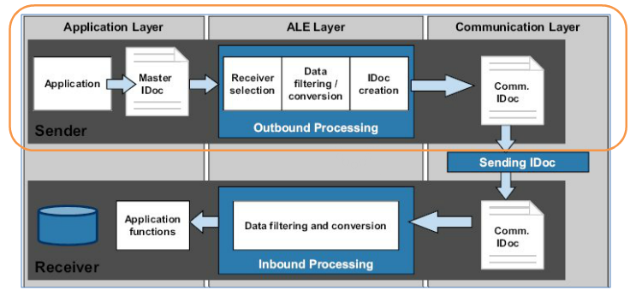
Outbound Processing
Notes:
如上图outbound processing的流程可以理解为以下几个步骤：
应用层：生成应用数据
ALE层：创建出站IDCO
通讯层：寻找伙伴和端口
发送IDOC

Slide 16
Outbound Processing using message control
SAP Application
Document
Document
Message Control (MC)
MC
MC
record
record
IDoc Interface / ALE Services
IDoc
IDoc
External System
Notes:
IDOC可以通过不同的机制发送IDOC:
通过应用模块的消息控制间接的传送到IDOC接口
直接从应用发送到IDOC接口，这些处理主要是通过如下FM控制
标准： MASTER_IDOC_DISTRIBUTE/COMMUNICATION_IDOC_CREATE
自定义IDOC: L_IDOC_SEND/L_IDOC_SEGMENT_CREATE/L_IDOC_HEADER_CREATE.

Slide 17
Outbound Processing using ALE
SAP Application
Master IDoc
Master IDoc
IDoc Interface / ALE Services
Comm. IDoc
Comm. IDoc
Comm. IDoc
Comm. IDoc
Comm. IDoc
Comm. IDoc
External System
Notes:
IDOC可以通过不同的机制发送IDOC:
通过应用模块的消息控制间接的传送到IDOC接口
直接从应用发送到IDOC接口，这些处理主要是通过如下FM控制
标准： MASTER_IDOC_DISTRIBUTE/COMMUNICATION_IDOC_CREATE
自定义IDOC: L_IDOC_SEND/L_IDOC_SEGMENT_CREATE/L_IDOC_HEADER_CREATE.

Slide 18
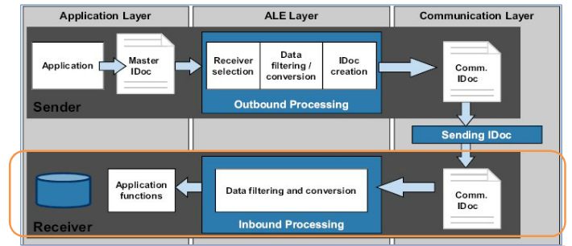
Inbound Processing
Notes:
如上图Inbound processing的流程可以理解为以下几个步骤：
通讯层：接收入站端口传进来的数据
ALE层：创建入站IDOC并通过伙伴参数文件查找IDOC处理类型
应用层：写入文档

Slide 19
Inbound Processing using Workflow
External System
IDoc
IDoc
IDoc Interface & ALE Services
IDoc +
IDoc +
process
process
SAP Business Workflow
Document
Document
SAP Application

Slide 20
Inbound Processing using ALE
External System
IDoc
IDoc
IDoc Interface & ALE Services
IDoc
IDoc
SAP Application

Slide 21
IDOC Interface: Port Types
IDoc Interface
IDoc/
IDoc/
IDoc/
IDoc
IDoc
IDoc
IDoc/
IDoc
status
IDoc
IDoc
IDoc
status
IDoc
status
status
File
XML
tRFC
Internet
CPI-C
PI
?
External System
R/2 System
Notes:
IDOC通过端口和目标系统交换数据，它是接口中通讯基础，如上示意图：
RFC事物： ALE分布式传输过程端口，外部系统也是R/3的解决方案
交接接口： 以文件形式输出，外部系统可以读取此IDOC文件
CPI-C: 连接到R/2系统
ABAP-编程接口：将IDOC文件发送到用户定义的FM，以实现特殊的逻辑
XML文件格式：输出到XML文件
HTTP格式的XML文件：输出到MIME(Multipurpose Internet Mail Extensions)文件格式

Slide 22
Agenda
IDoc Concept
IDoc Configuration Steps
IDoc Creation example

Slide 23
Steps of IDoc Configuration (PO).
Basic Setting:
  1. WE60 – IDoc types and segments (SAP Standard Document)
  2. IMG – Setting for output messages
Outbound IDoc Process:
  1. WE31 – Create IDoc Segments
  2. WE30 – Create IDoc Type (Basic & extension)
  3. WE81 – Create Message Type
  4. WE82 – Assign Message Type to IDoc Type (Basic & extension)
  5. SM59 – Maintain RFC Destinations
  6. WE21 – Port Maintenance
  7. BD54/SALE – Create Sender Logical System
  8. WE20 – Partner Profiles setting
  9. CMOD – User exist for assign add-on field value
  10. MN04/MN07 – Create condition record for PO/SA Output message

Slide 24
Steps of IDoc Configuration (PO).
Inbound IDoc Process:
  1. WE31 – Create IDoc Segments
  2. WE30 – Create IDoc Type
  3. WE81 – Create Message Type
  4. WE82 – Assign Message Type to IDoc Type
  (Above 4 step the same as outbound process)
  5. SE37 – Create FM for add code for create Inbound IDoc
  6. DB51 – Register FM
  7. WE57 – Assign message type & IDoc type to a FM
  8. WE42 – Create inbound process code (绑定FM)
  9. BD54/SALE – Create Receiver Logical System
  10. WE20 – Partner Profiles setting
Administration
  WE02/WE05 – IDoc Display
Notes:
WE20: Create Partner Profile(这一步和Inbound & Outbound Process中不同，inbound process只需要配置Message Type和Process Code)
WE42: 创建Inbound Process Code(绑定FM)，选择是否通过ALE服务

Slide 25
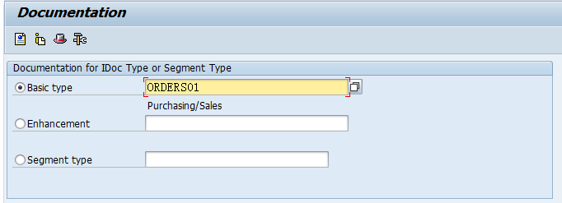
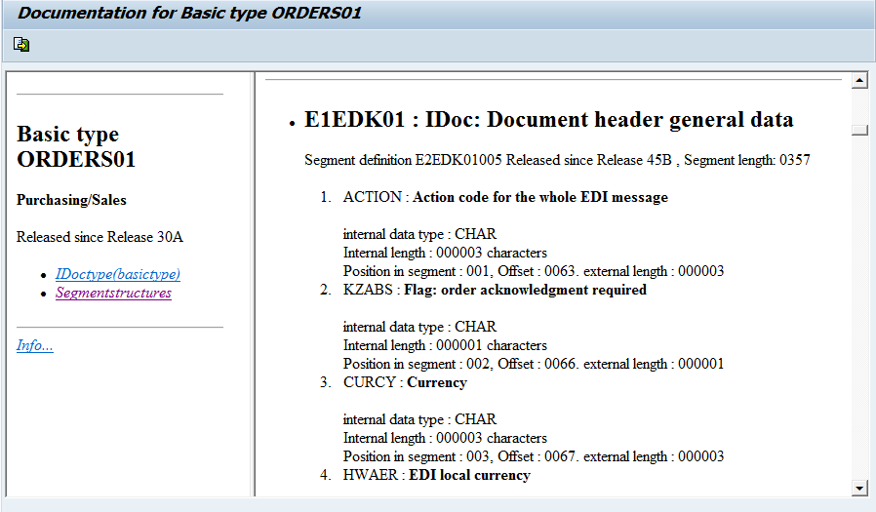
Basic Setting – WE60: Check IDoc type info.

Slide 26
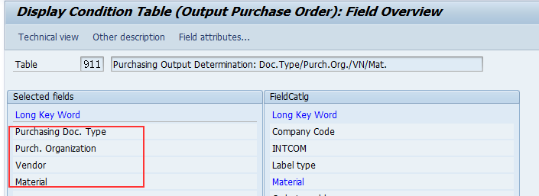
Basic Setting – IMG: Setting output messages
Step1: Condition table
  SPRO-> Materials Management -> Purchasing -> Messages -> Output Control -> Condition tables -> Define Condition Table for Purchase Order-> (Messages: Create Condition Table: Purchase Order)
  By Purchasing Doc. Type & Purch. Org.& Vendor & material to control output the IDOC for PO

Slide 27
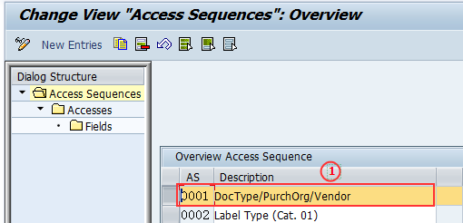
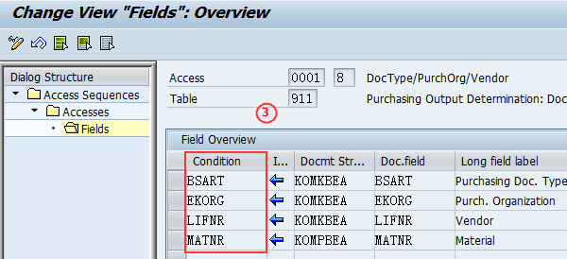
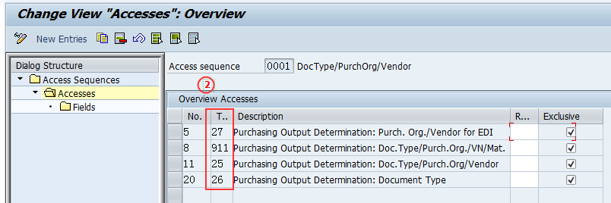
Basic Setting – IMG: Setting output messages
Step2: Access Sequences
  SPRO-> Materials Management -> Purchasing -> Messages -> Output Control -> Access Sequences -> Define Access Sequences for Purchase Order

Slide 28
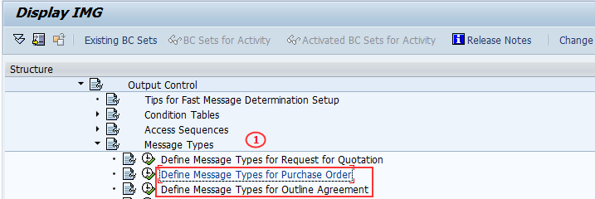
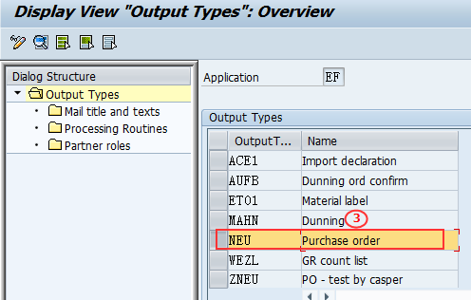
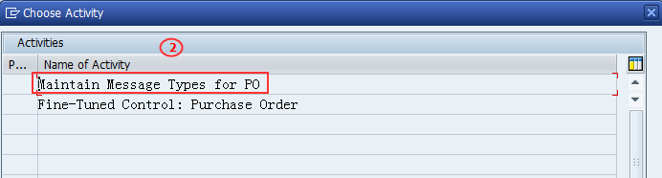
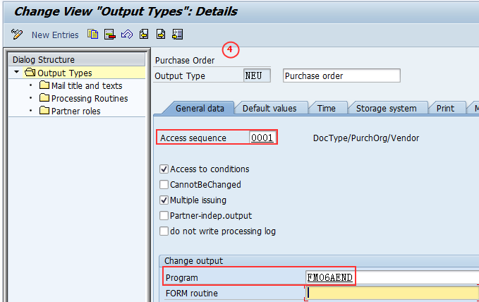
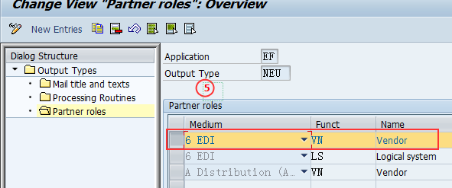
Basic Setting – IMG: Setting output messages
Step3: Message Type – (A)
  SPRO-> Materials Management -> Purchasing -> Messages -> Output Control -> Message Types -> Define Message Types for Purchase Order

Slide 29
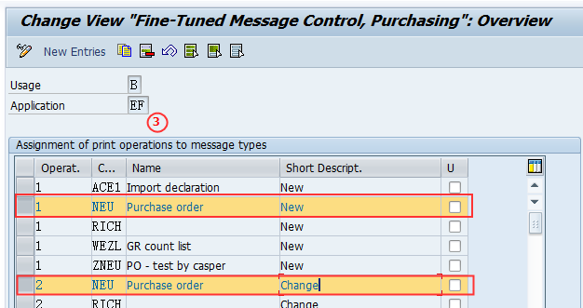
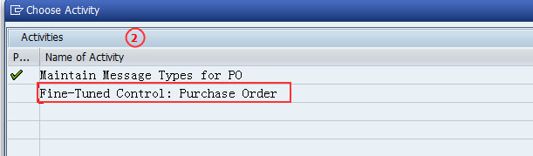
Basic Setting – IMG: Setting output messages
Step3: Message Type – (B)
  SPRO-> Materials Management -> Purchasing -> Messages -> Output Control -> Message Types -> Define Message Types for Purchase Order

Slide 30
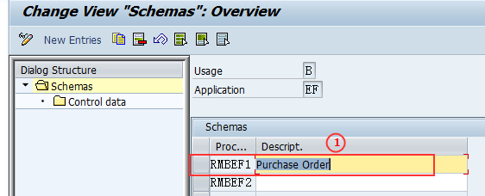
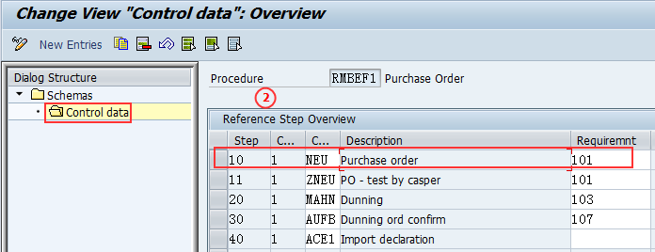
Basic Setting – IMG: Setting output messages
Step4: Message Determination Schemas
  SPRO->Material Management-> Purchasing -> Message -> Output Control->Message Schema->Define Message Schema for Purchase Order-> Maintain Message Determination Schema

Slide 31
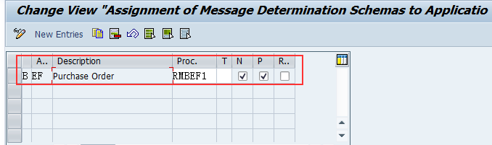
Basic Setting – IMG: Setting output messages
Step5: Assign Schema to Purchase Order
  SPRO->Material Management-> Purchasing -> Message -> Output Control->Message Schema->Define Message Schema for Purchase Order-> Assign Schema to Purchase Order

Slide 32
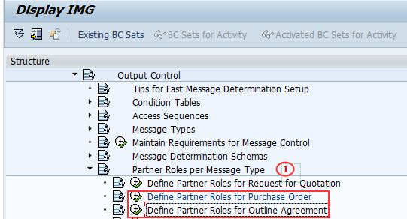
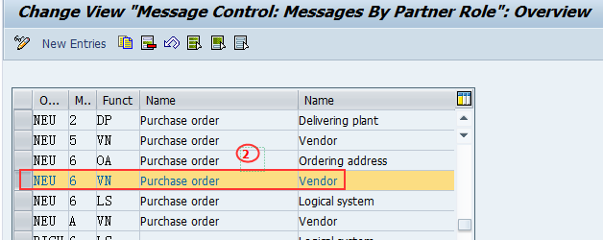
Basic Setting – IMG: Setting output messages
Step5: Partner Role per Message Type
  SPRO-> Materials Management -> Purchasing -> Messages -> Output Control -> Partner Roles per Message Types -> Define Partner Roles for Purchase Order

Slide 33
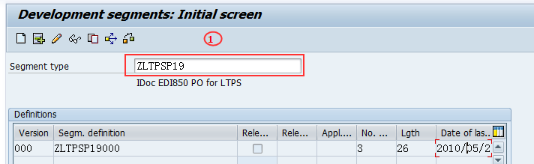
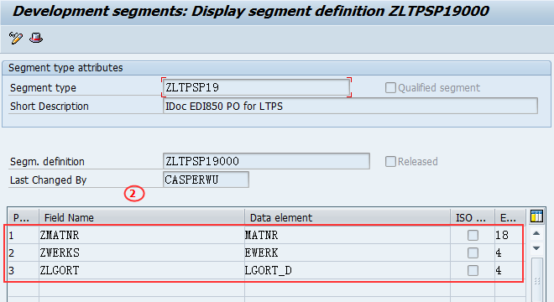
Outbound IDoc Process
WE31 - Create Segment for add-on field
- For new project, may need to add new segment for add-on fields

Slide 34
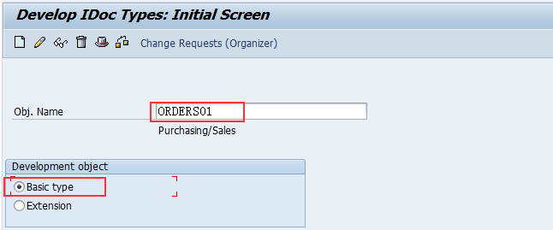
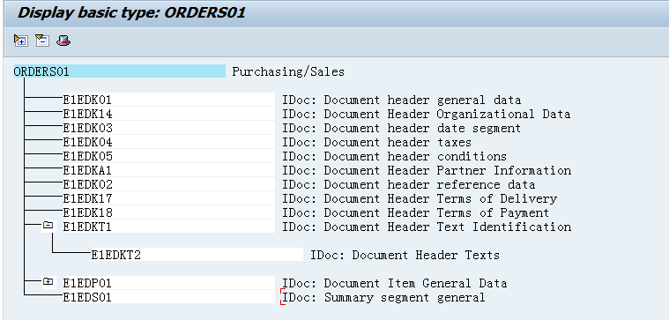
Outbound IDoc Process
WE30 - Display Basic IDoc Type

Slide 35
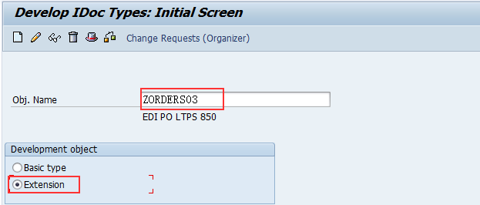
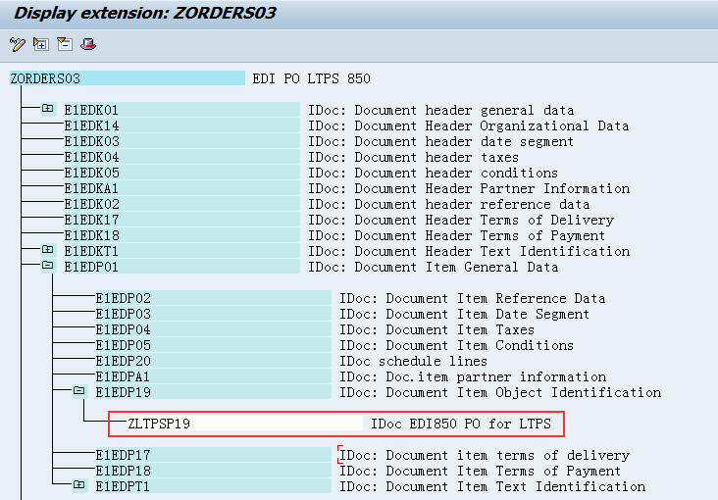
Outbound IDoc Process
WE30 - Create extension IDoc Type and assign Segment to IDoc

Slide 36
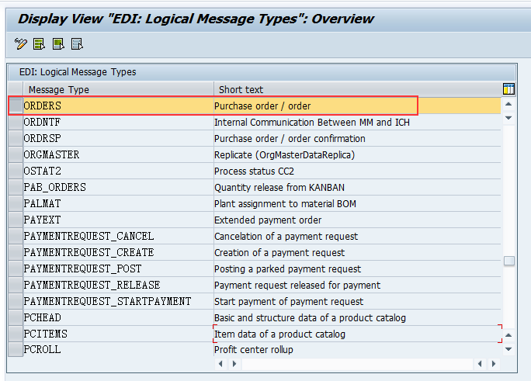
Outbound IDoc Process
WE81: Create Message Type.

Slide 37
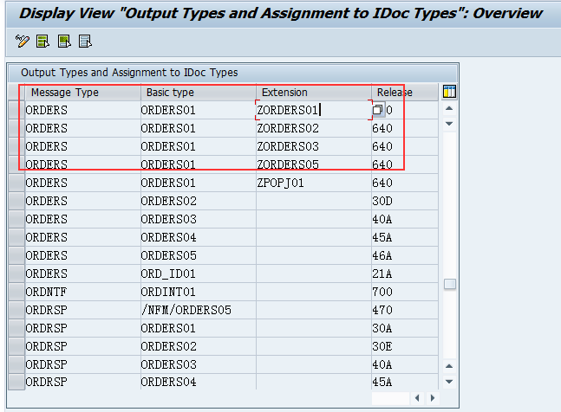
Outbound IDoc Process
WE82: Assign basic type & extensions to message type.

Slide 38
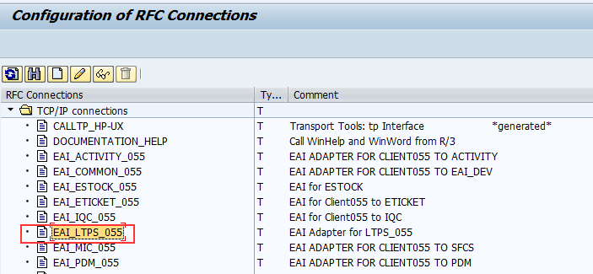
Outbound IDoc Process
SM59: Maintain RFC Destinations
Notes:
RFC Destination:
Used to define the characteristics of communication links to a remote system on which a functions needs to be executed.

Slide 39
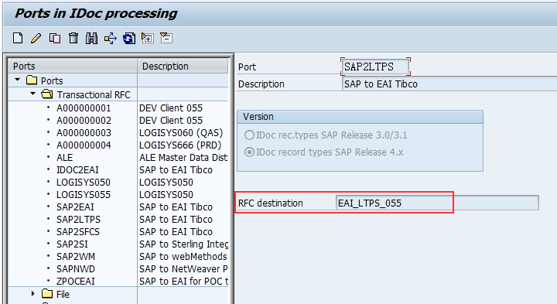
Outbound IDoc Process
WE21: Port Maintenance
- Maintain the destination for the Port ‘SAP2LTPS’
Notes:
Port is used in the outbound process to determine the name of the EDI subsystem program,the directory path where the idoc file will be created at the operating system level,the idoc file names and the rfc desinations.

Slide 40
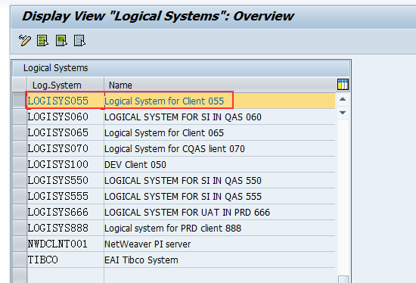
Outbound IDoc Process
BD54/SALE: Create Sender Logical System
Notes:
Logical system将作为之后R/3系统接受IDOC数据的Partner
Logical system用来识别同一个服务器上不同的client，用Tcode SCC4将logical system指派给client

Slide 41
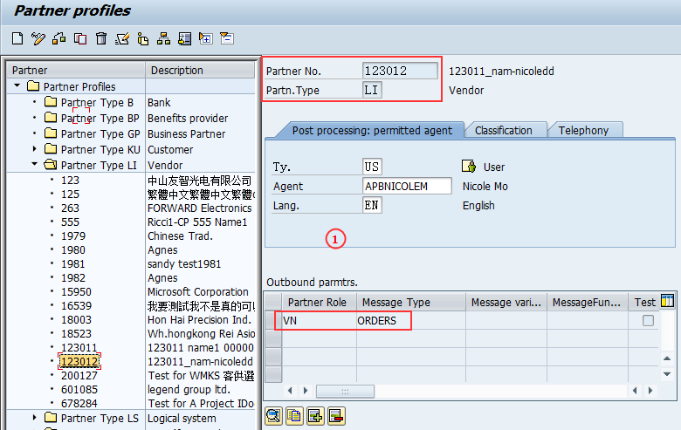
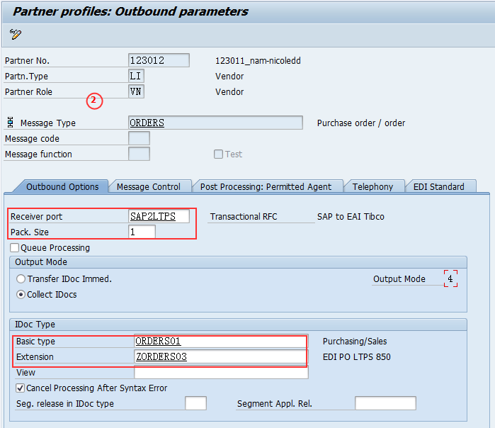
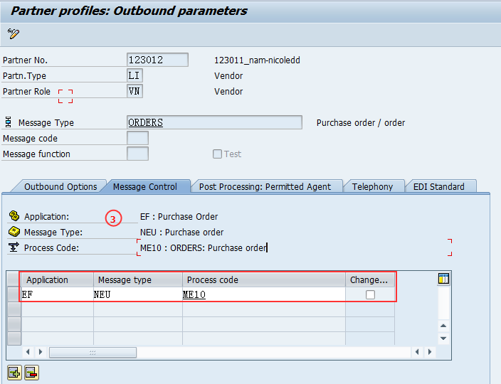

Outbound IDoc Process
WE20: Partner Profiles setting
- Create Partner profile ‘LI’ (Vendor)
Click here
Notes:
Partner profile specified the various componets used in an outbound process ( Partner number,IDoc type,message type,Port,Process code),the mode in which it communicates with the subsystem(batch or immediate) and the person to be notified in case of errors.
此处的message control在IDOC中起触发IDOC执行的作业，通过配置可以在支持输出类型的对象中触发IDOC

Slide 42
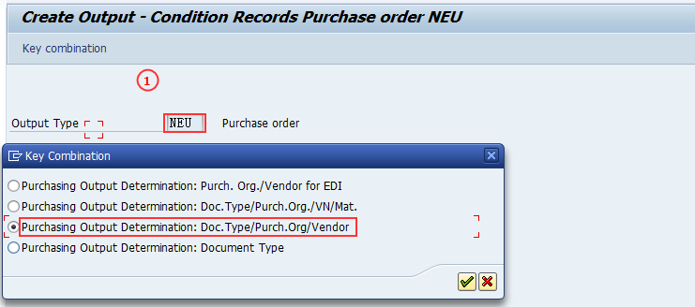
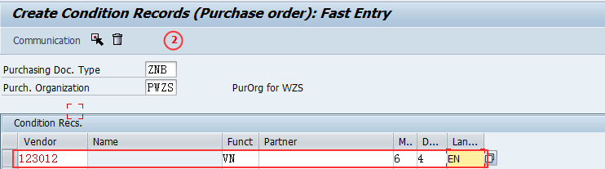
Outbound IDoc Process
MN04/MN07 – Create condition record for PO/SA Output message
Notes:
Partner profile specified the various componets used in an outbound process ( Partner number,IDoc type,message type,Port,Process code),the mode in which it communicates with the subsystem(batch or immediate) and the person to be notified in case of errors.

Slide 43
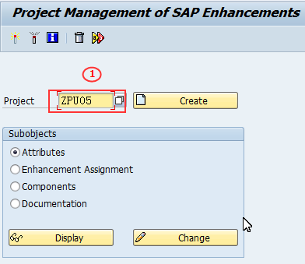
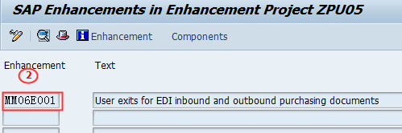
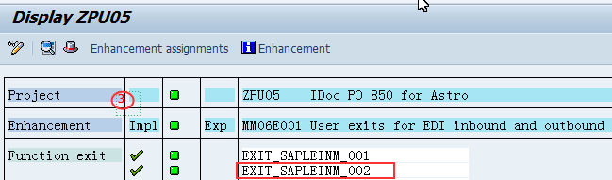
Outbound IDoc Process
CMOD : User exit development for insert value to add-on fields
- Project: ZPU05
- Enhancement : MM06E001.

Slide 44
Agenda
IDoc Concept
IDoc Configuration Steps
IDoc Creation example

Slide 45
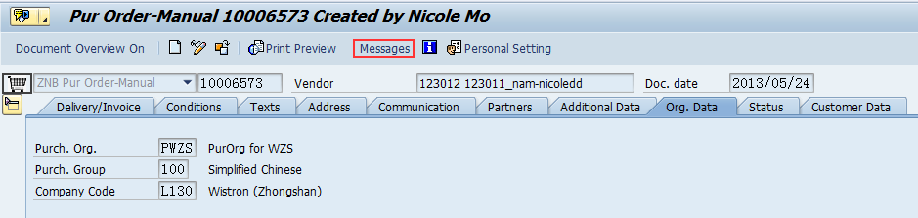
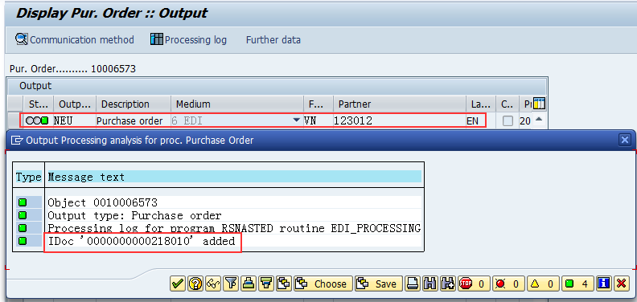
Generate PO outbound IDoc
ME21N: Create PO for generate IDoc
- PO Type: ZNB, Vendor: 123012,
- After save PO go to ‘Message’ to check IDoc generate log

Slide 46
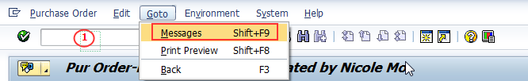
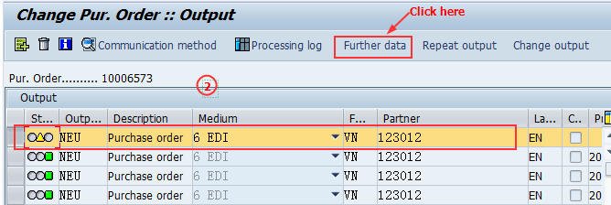
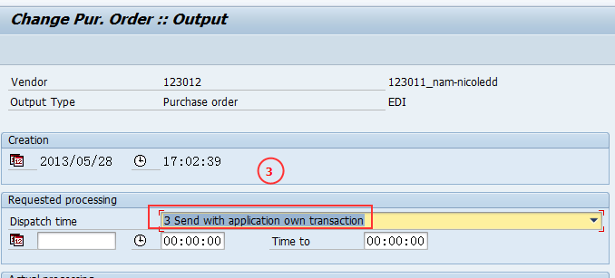
Manual outbound PO IDoc
Step 1: Go to ME22N to set message

Slide 47
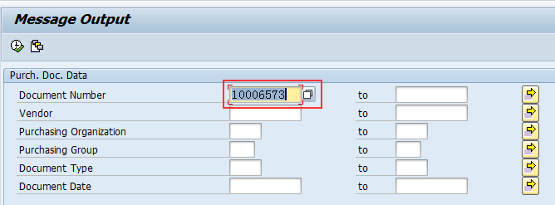
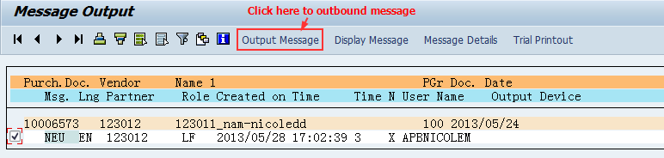
Manual outbound PO IDoc
Step 2: Go to ME9F to outbound message

Slide 48
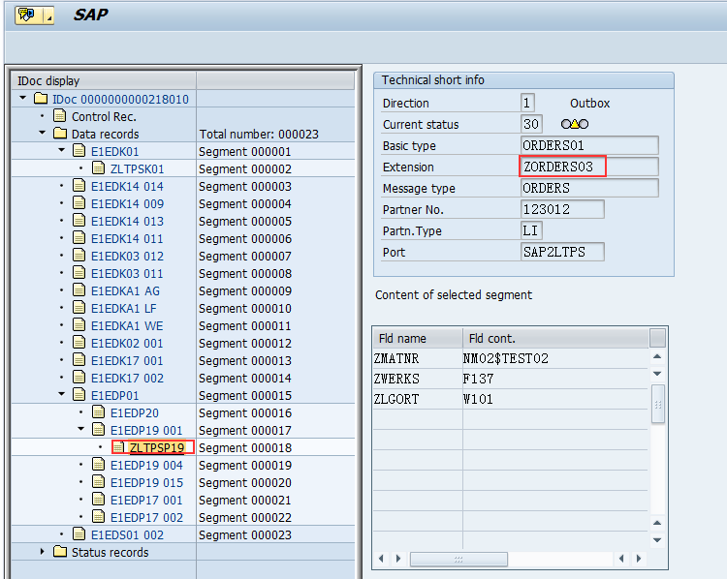
Display PO IDoc
WE02: Display IDoc

Slide 49
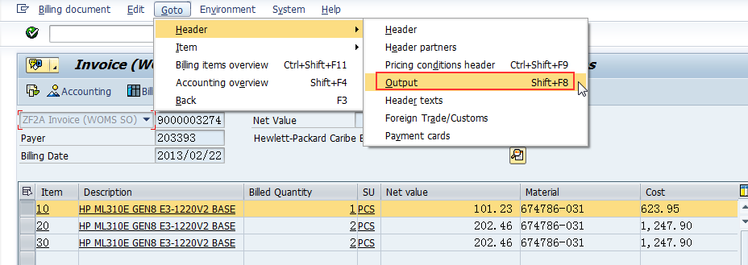
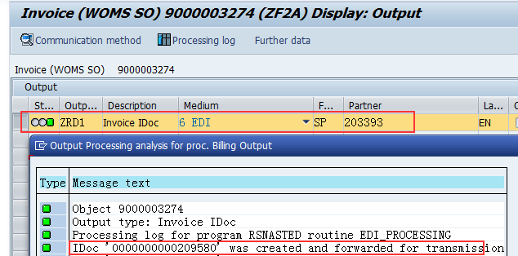
Generate Billing outbound IDoc
IDoc Configuration Steps of Billing are all most the same as PO
VV31: Create output type (ZRD1: Normal invoice IDOC)
WE20: Partner profile Setting: Partner type as ‘KU’ (Customer)
VF01: Create Billing
VF31: Resend IDOC

Slide 50
Inbound IDoc Process
WE57: Assign message type & Idoc type to a function module
- Assign function module “IDOC_OUTPUT_ORDERS” to log message and message type
Example: ZIMI00033

Slide 51
Wistron Implement IDoc
MM: Purchase Order
Astro EDI850
  - Message Type: ORDERS (Purchase order / order)
  - Basic IDoc Type: ORDERS01 (Purchasing/Sales)
  - Extension: ZORDERS01 (Linked basic type ORDERS01)
EDI850 for LTPS & HOPS
  - Message Type: ORDERS (Purchase order / order)
  - Basic IDoc Type: ORDERS01 (Purchasing/Sales)
  - Extension: ZORDERS03 (Linked basic type ORDERS01)
SD: Customer master IDOC &Invoice IDOC
Outbound Customer master data to WOMS and PPS via EAI TIBCO.
IDOC message type output type:
  ‘DEBMAS’ IDOC for customer master
  ‘ADRMAS’ IDOC for customer address data.
Outbound Invoice IDOC: INVOICE EDI 810 to B-Global via TIBCO EAI
  - Message Type: INVOIC
  - Basic IDoc Type: INVOIC02
  - Extension: ZINVOIC02

Slide 52

Q & A
Thank you!

